Slide 1
Design Review
Product: Portable Wireless Speakers with LED Capabilities
Team: JAK-EE chan
Members: Jeremy Doll, Ahmad Mostafa, Keil Toso
Notes:
All of us introduce ourselves

Slide 2
Project Description
Portable wireless speakers with LED strips that light to different audio frequency ranges.
Beat detection filters with matching LED’s.
LED system that directly respond to music, and which also allows user-input.
Diffusing layer to make LED’s bright yet enjoyable to look at.
Small wooden casing for easy transportation.
The speakers will be a great option for people who enjoy lights with music in calm or exciting settings.
Notes:
Keil

Slide 3
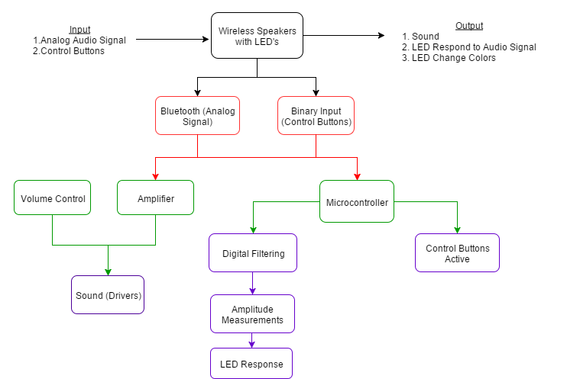
Block Diagram
Notes:
Jeremy

Slide 4
Specifications
The system shall output audio selected from Bluetooth-capable devices to two speaker drivers. The system shall illuminate three LED strips consisting of at most 10 LED’s each. The LED’s can alternate between at least three different colors. Speakers can be carried and moved by one person.
Attribute | Specification
Battery | Rechargeable, Lithium-Ion: 3800mAh, 12V
Run-time | 2 hours minimum before battery needs to be re-charged
Size | No larger than 36in x 36in x 36in
Weight | No more than 10 lbs
LED Supply Voltage | 5V
Minimum Speaker Voltage | 5V
Notes:
Jeremy

Slide 5
Technical Details: Software Plan
Producing sound from the speakers:
Signal from audio source will be captured by Bluetooth module.
The analog signal will be sent to a boost amplifier and output to the drivers.
Most of the software development will deal with the LED strips.
Three LED strips light up with the bass, treble, and midtone frequencies.
The Teensy 3.2 microcontroller will be used to achieve this:
The audio signal being captured by the Bluetooth module will also be sent to the audio adapter board, and then to the microcontroller.
Signal will be analyzed in the frequency domain using an FFT.
Digital filters are applied to split the frequencies into three separate ranges.
Through trial and error, the proper frequency ranges will be selected.
If the amplitude of a specific frequency passes a selected threshold, then the corresponding LED strip will illuminate.
The rest of the software design will deal with controlling the LED colors.
When a button is pushed, it will send a binary signal to the microcontroller.
Depending on which button is pressed, the microcontroller sends a corresponding signal to select a particular color.
Notes:
Ahmad
mention that we have a plan, but no the architecture of the program. that is something we are behind on and will be tackling this class period

Slide 6
Technical Details: Hardware
The chassis of the speakers will be handmade from free scrap wood.
The LED strips will be mounted on a PCB (inserted internally).
Viewed from outside through diffuser screen
Power distribution for the system must be taken into consideration because each separate component has a minimum and maximum allowable voltage.
A battery will be inserted inside the system.
Voltage regulator circuits will be implemented to account for each component.
Internal organization
The placement of internal components will be confined but with all parts accessible.
This will conserve space.
It will also make it easier to replace components in the future if needed.
Every element of the system must be securely placed to prevent damage from unwanted movement.
Microcontroller Function
The Teensy 3.2 USB Development Board will control the LED’s and receive user input.
The Teensy Audio Adapter board will convert the analog signal from the
Bluetooth module to a data stream readable by the Teensy 3.2.
Notes:
Keil

Slide 7
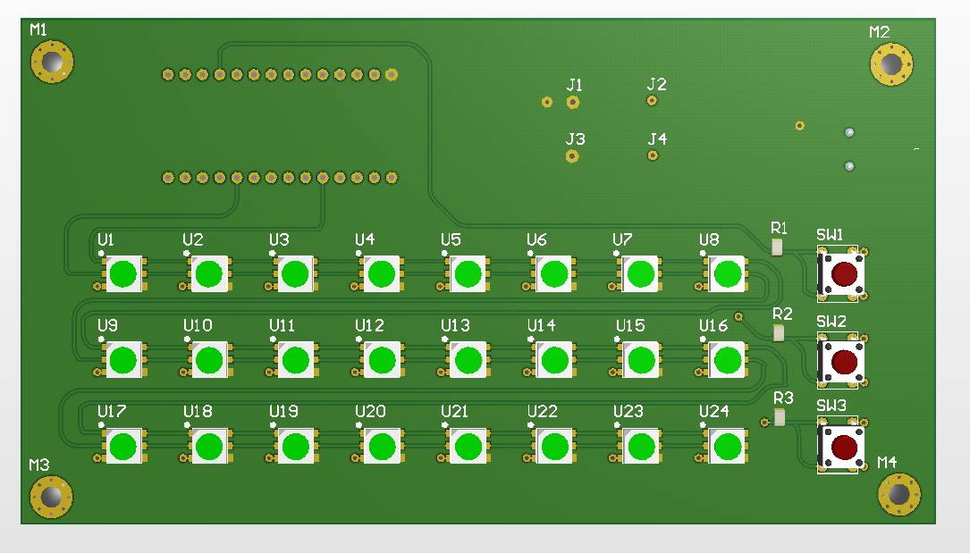
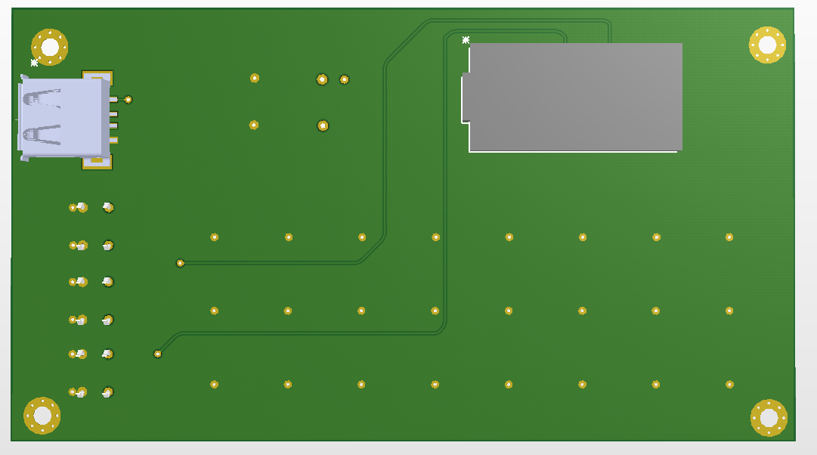
Printed Circuit Board (PCB) Designs
Front
Back
Notes:
Jeremy

Slide 8
Completed and Future Accomplishments
Completed
Interface between Bluetooth-capable device and Bluetooth module.
Assemble list of required parts and order the parts.
Realize PCB layout.
Circuitry Design.
Communicated LED’s with Teensy 3.2.
Future
Implement audio filters to trigger the LED strips.
Program user-controlled LED color system.
Submit PCB design to company and place order.
Solder components to completed PCB board.
Design and build speaker chassis.
Notes:
Jeremy, tradeoffs include: choice of bluetooth, not implementing buck converter on board, amps

Slide 9
3d. Schedule
Date | Task
1/11 | Begin Class
1/13 | Choose Groups
1/20 | Complete Project Statement
2/1 | Complete Design Plan
2/3 | Finalize part choices
2/5 | Order all components (excluding PCB)
2/17 | Milestone 1- Teensy interfaced with LED’s
2/29 | PCB design reviewed and submitted
3/2 | Design Review- Power circuit realized with chosen battery/ LED’s installed
3/16 | Milestone 2- LED equalizer realized
4/6 | Milestone 3- Working model fitted inside speaker casing
4/27 | Final Review- Bluetooth Speaker with LED capabilities finished
Completed tasks
Notes:
Ahmad

Slide 10
Manpower
Ahmad
Interface between Bluetooth-capable device and Bluetooth module.
Implement audio filters to trigger the LED strips.
Program the user selection of LED colors.
Jeremy
Assemble list of required parts and order the parts.
Design power, audio conditioning, and voltage step up/down circuitry.
Realize PCB layout and submit to prospective company.
Keil
Program communication between Bluetooth module and microcontroller.
Solder components to completed PCB board.
Design and build speaker casing.
Notes:
Keil, then summarize everything

